Slide 1
Asymmetric Activation Function
Maksud alam
Id-16201033
Sec- 02
cse425

Slide 2
ACTIVATION FUNCTIONS

Slide 3
ASYMMETRIC ACTIVATION FUNCTION NAMES-
1. Sigmoid Function
2. RELU
3. ELU
4. Leaky RELU
5. SELU

Slide 4
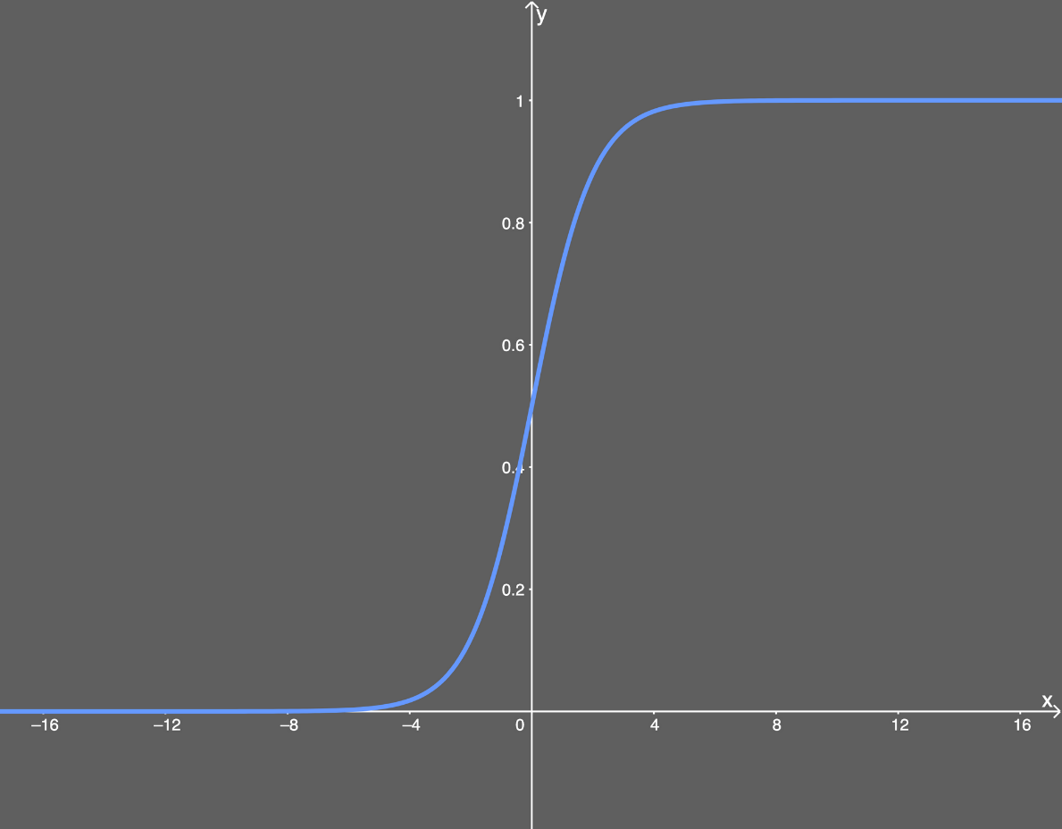
Sigmoid Function
- What is sigmoid function?

Slide 5
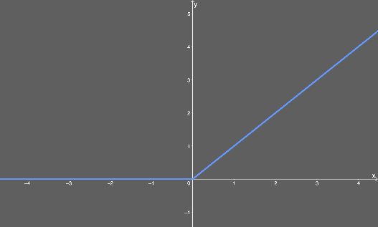
RELU
- What is RELU?
- Advantages.
- Disadvantages.

Slide 6
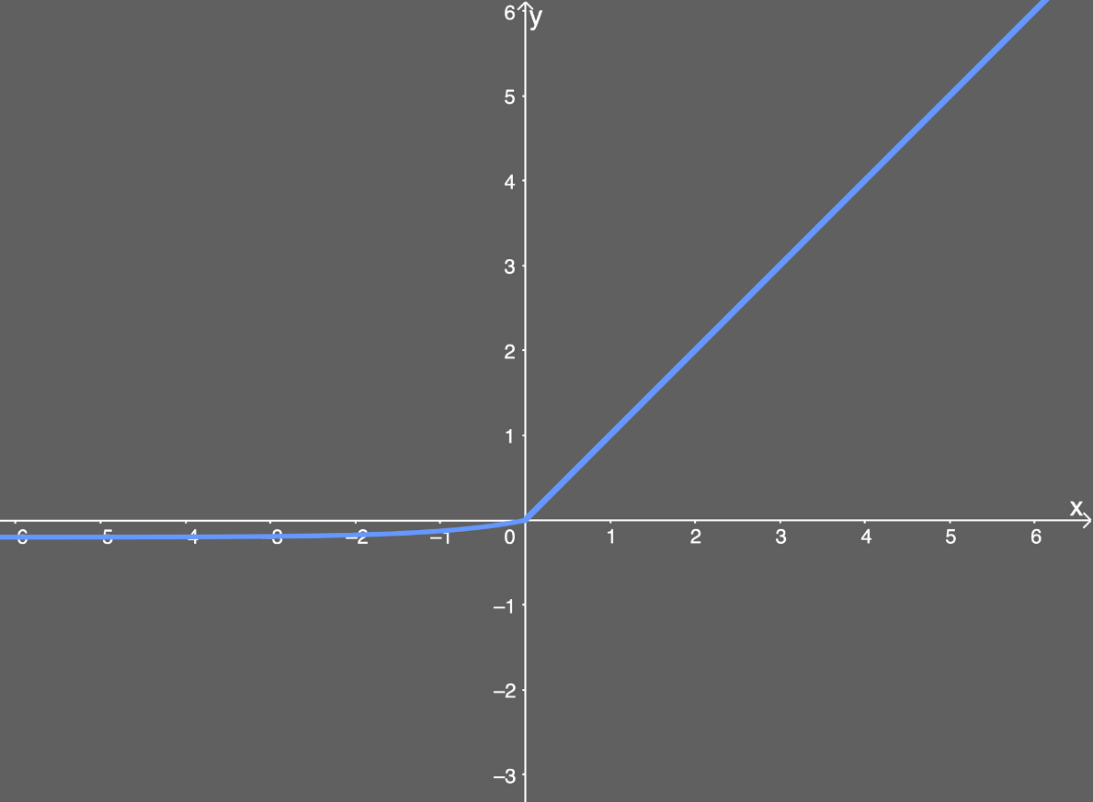
ELU
- What is ELU?
- Advantages.
- Disadvantages.

Slide 7
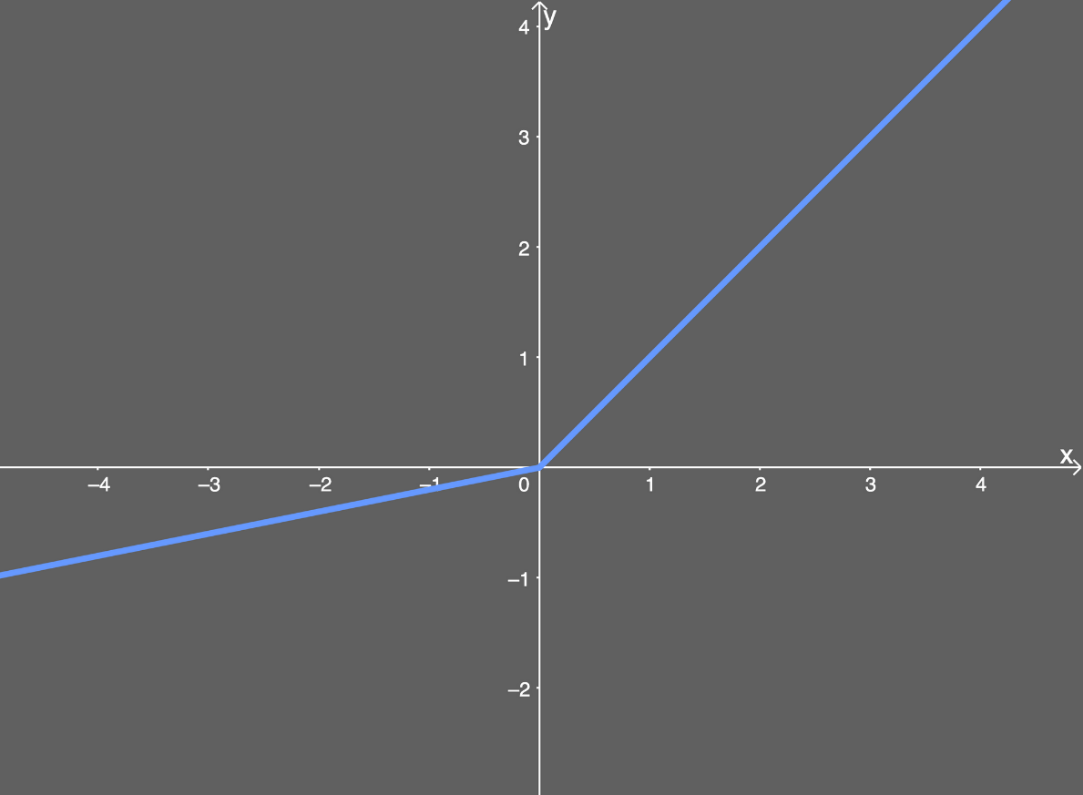
Leaky RELU
- What is Leaky RELU?
- Advantages.
- Disadvantages.

Slide 8
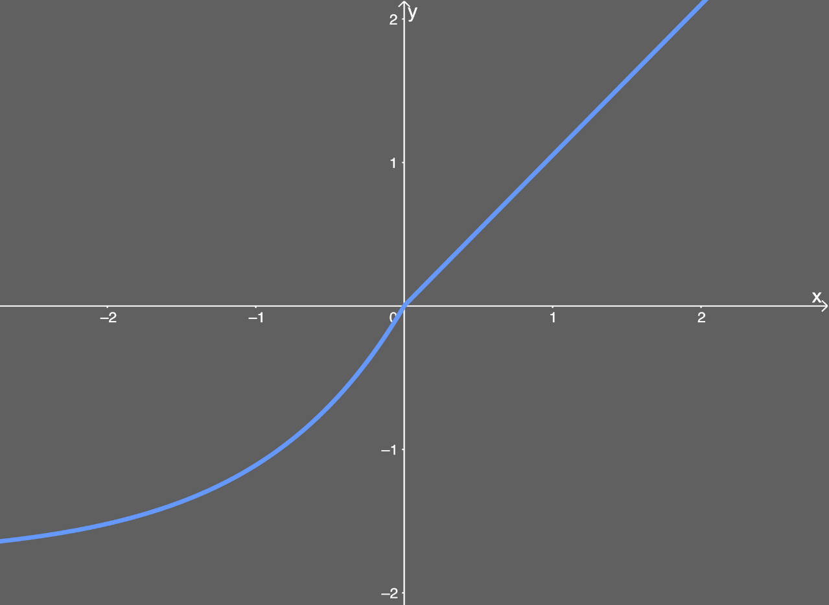
SELU
- What is SELU?
- Advantages.
- Disadvantages.

Slide 9
CONCLUSION.

